Slide 1




RAKSHA PIPE
Business Analyst Assignment
Presented By: Abhay Kumar
Contact - +91 9475610892

Slide 2

1
About Raksha Pipes
2
Assignment Overview
3
Product Type
4
Generate Data in Python
Agenda
5
Design Database
6
Schema Diagram
7
Database in MySQL
8
Connect Database
9
Power Bi Dashboard
10
Conclusion

Slide 3


1. Pioneered PVC piping in India for safe water access.
2. Innovated flexible pipe manufacturing.
3. Established Raksha Pipes as a national leader.
4. Diversified product range for comprehensive solutions.
5. Exported globally while maintaining quality.
6. Built a strong nationwide distribution network.
7. Maintained family-owned values for 44+ years.
8. Committed to customer satisfaction through tailored services.
9. Invested in R&D for continuous innovation.
10. Aspired for global industry leadership.
About Raksha Pipes
Raksha Pipes, a manufacturer of PVC, UPVC, and CPVC pipes, and plumbing and drainage solutions. They emphasize their experience, quality commitment, and customer satisfaction.

Slide 4







Product Type
Agriculture | Water Tank
Plumbing | Cleaning Solutions
Industrial
PTMT Bath Fittings And Accessories

Slide 5
Assignment Overview
Generate Data and Design Database.
Set Up Database in MySQL.
Create Dashboard in Power BI

Slide 6

Generate Data in Python
1. Customers: Generated fake customer data including names, addresses, phone numbers, and email addresses.
2. Products: Created fake product data with information such as product type, subtype, name, description, price, and stock quantity.
3. Sales: Generated fake sales data including sale type, product name, quantity, price, discount price, and total amount.
4. Orders: Simulated orders data with customer IDs, product IDs, quantities, and order dates.
5. Payments: Created fake payment data including customer IDs, product names, amounts, payment dates, and modes of transactions (UPI, Credit Card, Debit Card, Cash, Bank Transfer).
6. Profit Margins: Calculated fake profit margins based on sales quantities, total prices, and profits for different product types.
7. Annual Sales: Generated annual sales data for multiple years, categorized by sales channels (Online, In-Store, Phone Order, Wholesale). 8. Customer Feedback: Created simulated customer feedback data with feedback comments, scores, and keywords reflecting customer sentiments.

Slide 7
Design Database
1
2
3
4
Customer Profile
Products Name / Type
Sales
Orders
5
6
7
8
Payments
Profit Margins
Annual Sales
Customer Feedback

Slide 8
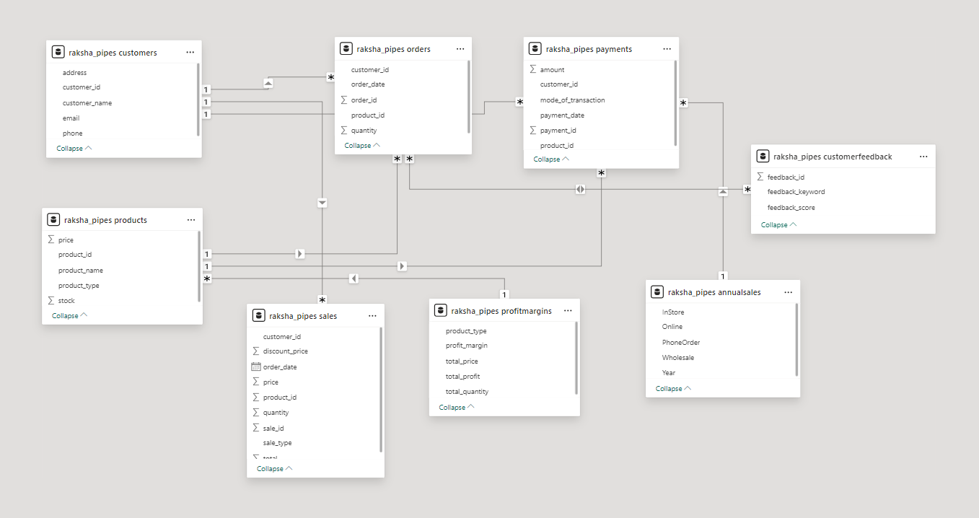

Schema Diagram

Slide 9

Set Up Database in MySQL
Create the database in MySQL and add generated data
Database Creation: Setting up the MySQL database.
Data Import: Adding generated data to the database.

Slide 10

Connect Database
Process: Establish connection between MySQL database and Power BI.
Tools: Utilize Power BI's data connectivity features.
Importance: Accessing real-time data for dashboard visualization.

Slide 11
Build Dashboard
Components: Sales trends, product performance, customer profiles, and etc.
Interactivity: Ensure user-friendly interface for data exploration.
Importance: Providing insights into business performance and customer behavior.

Slide 12

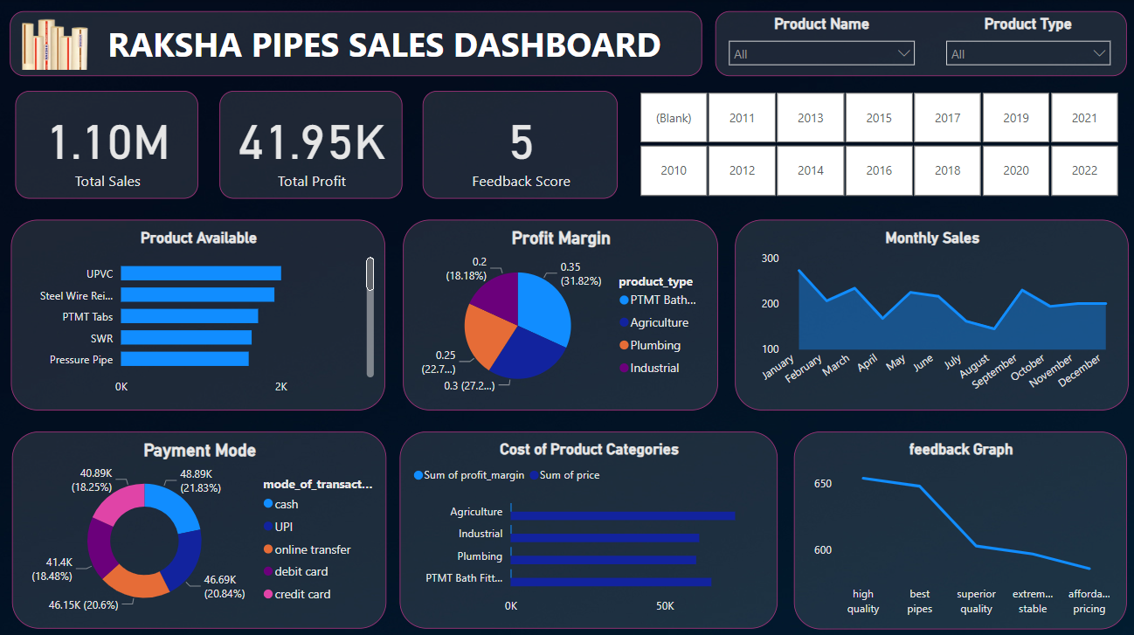
Dashboard

Slide 13

This assignment tasked us with building a data management and visualization system for Raksha Pipes. We generated realistic data, designed a MySQL database with interconnected tables, implemented it, and created an interactive Power BI dashboard displaying sales trends, product performance, and customer profiles. Effective data management and visualization are crucial for Raksha Pipes' success in today's competitive landscape.
Conclusion

Slide 14

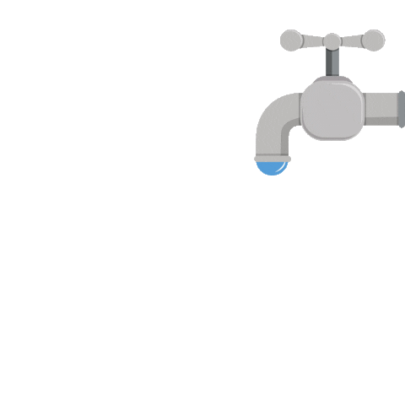

THANK YOU

